Slide 1

Making the Davis-Putnam procedure more efficient
Frank van Harmelen
Vrije Universiteit Amsterdam

Slide 2
Remember the Davis-Putnam algorithm
It consists of two stages:
It checks a few easy cases, and if such an easy case exists it can assign the right value to one of the truth values
If there is no such easy case, it picks one of the letters and picks a truth value to it.
After assigning such a truth value in step 1 or 2, it simplifies the formula,
And then repeats the process with the simplified formula
The process stops
when all clauses have been satisfied (success!), or
when the set of clauses becomes inconsistent (failure)
If there is failure, that could be because we picked the wrong truth value for a letter in step 2. So we have to “backtrack”:
6. for the letter from step 2 we pick the other truth value, and try again.

Slide 3
How to pick the best predicate & value?
1. Counting the frequency of predicates
Pos(P) = nr of clauses with P
Neg(P) = nr of clauses with ¬P
Pick the P with the highest Pos(P)+Neg(P) (= most frequently occurring predicate)
Set P=1 if Pos(P) > Neg(P), else set P=0
Why does this work?
Choose predicates that occur often, and pick the truth value that removes the most clauses:
(A ∨ ¬B) ∧ (A ∨ G) ∧ (B ∨ C ∨ E ∨ F)
A and B appear most often; they have the highest Pos()+Neg()
For A, choose A=1 because Pos(A)>Neg(A):
(A ∨ ¬B) ∧ (A ∨ G) ∧ (B ∨ C ∨ E ∨ F)

Slide 4
How to pick the best predicate & value?
2. MOMS Heuristic Pick the literal that occurs Most Often in clauses of Minimal Size
=
assign variables with high occurrence in short clauses
Why does this work?
Give preference to small clauses (they are “easy”) - In those small clauses, pick the most frequent predicate (they give you the highest chance of having an effect.
Hard to beat for speed and simplicity

Slide 5
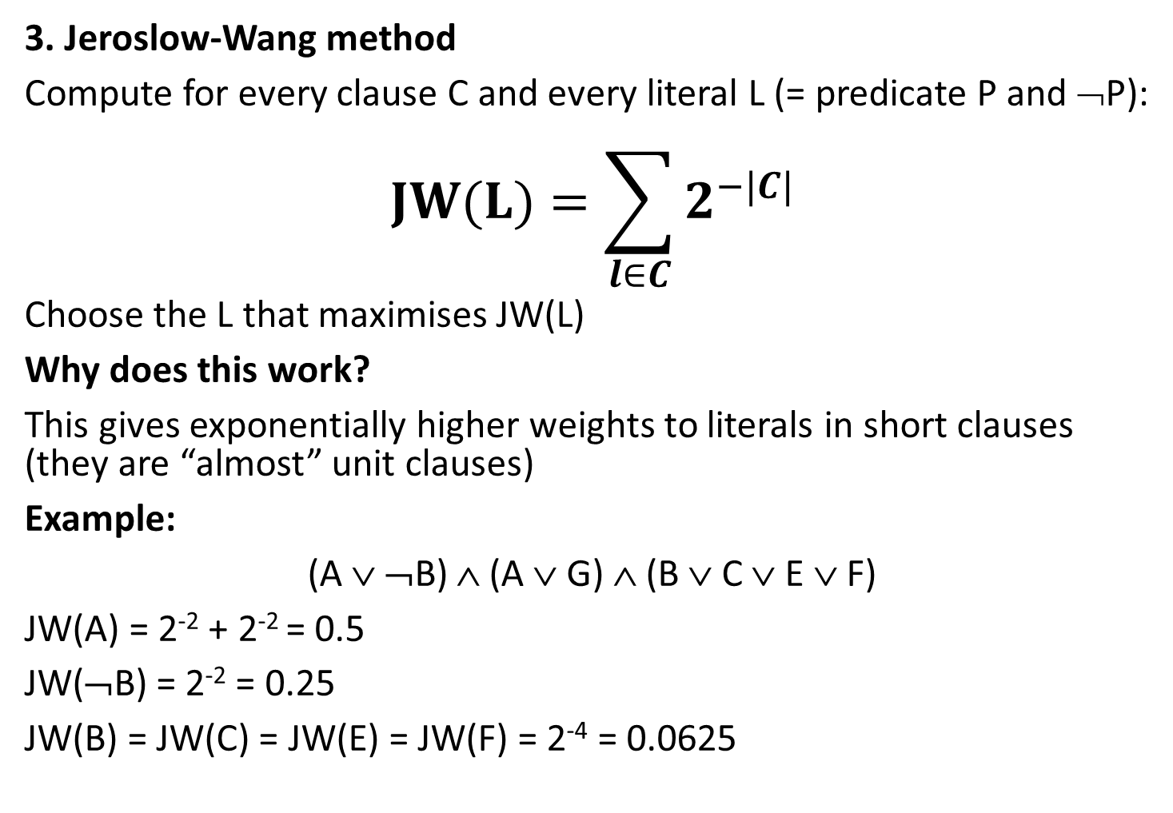
How to pick the best predicate & value?
3. Jeroslow-Wang method
Compute for every clause C and every literal L (= predicate P and ¬P):
$$JW(L)=\sum_{l∈C}{2^{−|C|}}$$
Choose the L that maximises JW(L)
Why does this work?
This gives exponentially higher weights to literals in short clauses (they are “almost” unit clauses)
Example:
(A ∨ ¬B) ∧ (A ∨ G) ∧ (B ∨ C ∨ E ∨ F)
JW(A) = 2⁻² + 2⁻² = 0.5
JW(¬B) = 2⁻² = 0.25
JW(B) = JW(C) = JW(E) = JW(F) = 2⁻⁴ = 0.0625

Slide 6
How to pick the best predicate & value?
If there is no such easy case, it picks one of the letters and picks a truth value to it.
There are many, many heuristics (= rules)
to choose the best predicate and truth value.
This greatly determines the efficiency of Davis-Putnam
One of the most important techniques is
Learning Conflict Clauses

